Slide 1
Texas High School Dropouts
By: Angie Ibarra
Catherin Claros
Prasad Dandgavhal

Slide 2
Agenda
Project Overview
Project Statement
DMAIC Process
Literary Review
Conclusion
Team Roles
Notes:
Today we are going to go over our team roles, project overview, project statement, DMAIC process, literary review, and conclusion

Slide 3
Team Members and Roles
Angie Ibarra (Team Lead): Process map, outline, WBS, Control Phase- 33%
Catherin Claros (Data Analyst): Raw data, data collection plan, Improve Phase- 33%
Prasad Dandgavhal (Data Analyst): Why is the data relevant, tools for analysis, root cause analysis, Improve- 33%
Team: Project Statement, Presentations, and Report
Notes:
Here are our roles for the team we did the project statement, our presentations, and the report. Angie is the team lead she worked on the process map to collect our data, project outline, wbs, and the control phase.
Catherin worked on collecting the raw data, data collection plan, and the improve phase.
Prasad found why data relevant, used the tools for analysis, making our fishbone diagram, and the improve phase as well.

Slide 4

Project Background
During 2013-2017 Texas was ranked 11 out of 15 with the highest high school dropout rates of 7.1%. In 2021 the Lone Star State was ranked 13 out of 20 with the dropout rate being 6.1%
In 2022-23 students who were economically disadvantaged were more likely to drop out by 2.7%. However, those who were not economically disadvantaged still had 1.2% drop out rate.
Austin. Secondary School Completion and Dropouts in Texas Public Schools 2021-22 TEXAS EDUCATION AGENCY. 2023. https://tea.texas.gov/reports-and-data/school-performance/accountability-research/dropcomp-2021-22.pdf
Notes:
Some background of our project is during 2013-2017 Texas was ranked 11 out of 15 with the highest high school dropout rates of 7.1%. In 2021 Texas was ranked 13 out of 20 with a dropout rate being 6.1%
In 2022-23 students who were economically disadvantaged were more likely to drop out by 2.7%. However, those who were not economically disadvantaged still had 1.2% drop out rate.

Slide 5
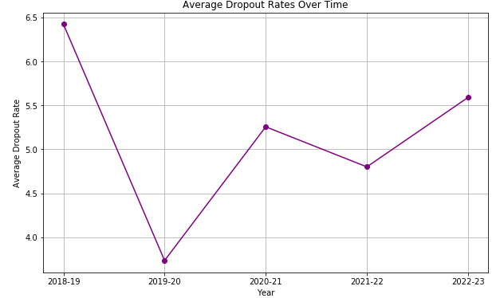
Project Statement
There has been 2.02% high school student dropout rate in Texas between 2018-2023, by finding factors contributing to the rising rates. We plan to reduce these rates by 1% by May 2026.
Texas Education Agency. (n.d.). Completion, Graduation, and Dropout Data. Retrieved from Texas Education Agency: https://tea.texas.gov/reports-and-data/school-performance/accountability-research/completion-graduation-and-dropout/completion-graduation-and-dropout-data
Notes:
As for our statement, it has thankfully not changed as much we saw the average dropout rate between 2018-2024 which was 2.02% high school statement dropout rate in Texas by finding factors contributing to the rising rates. We plan to reduce these rates by 1% by May 2026.

Slide 6

Define
What constitutes a dropout is when a student leaves school at any level of education without a certificate to account for their schooling period and education
The Goal: is to find all the factors that play into the students' decision to leave their studies and reduce the dropout rate
Objective: We want to reduce the number of high school dropouts in Texas. Reducing it by 1% would lead to more students graduating high school every school year
Target Audience: Students, teachers, parents, low-income families
Freeman, J., & Simonsen, B. (2015). Examining the Impact of Policy and Practice Interventions on High School Dropout and School Completion Rates: A Systematic Review of the Literature. Review of Educational Research, 85(2), 205-248. https://doi.org/10.3102/0034654314554431
Notes:
Moving on to our phases we defined what is considered a dropout is when a student leaves school at any level education we are focusing on grades 9-12 without a certificate to account for their schooling period and education
Our goal is to identify all these factors that play into the students' decision to leave their schooling and reduce the dropouts
Target Audience: Students, teachers, parents, and low-income families

Slide 7
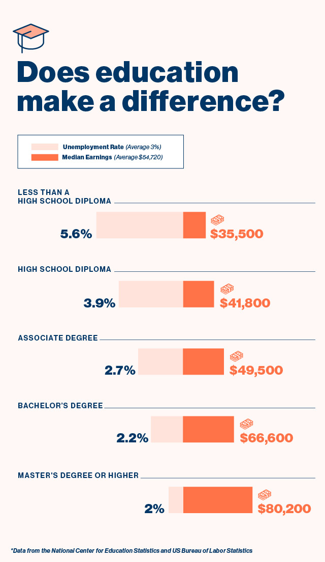
Justification
Having a high school diploma comes with many benefits that you don’t sit and think about as a teenager. A diploma is standard requirement for most employers when looking for a job having diploma It has also been determined that people with a diploma make an average of $10,000 more annually than those without. This also reduces the unemployment rate from 5.4% to about 3.7%.
Ref: Foster, P. (2022, September 27). 6 Advantages of Having A High School Diploma | Penn Foster. Www.pennfoster.edu. https://www.pennfoster.edu/blog/advantages-of-having-a-high-school-diploma

Slide 8
Possible deficiencies or shortcomings
Lack of Data on Parents’ Educational Background: The analysis lacked information on the educational background of students’ parents, which could have a significant impact on dropout rates. This is a potential limitation that needs addressing in future research.
Absence of Financial Data: Financial challenges faced by families were not included in the study. These factors are likely to have a substantial impact on student retention and should be integrated into future analyses to offer a clearer understanding of the socioeconomic barriers.
Underreporting as a Shortcoming: The data from 2022-23 shows several districts with underreported student numbers, which could skew the actual dropout rate. For instance, A+ Academy had 3 underreported students, leading to a 0.4% underreported rate, which may reflect issues with accurate data collection or hidden dropout trends (Based on the data).
Stanard, R. P. (2003). High school graduation rates in the United States: Implications for the counseling profession. Journal of Counseling & Development, 81(2), 217-221. https://onlinelibrary.wiley.com/doi/abs/10.1002/j.1556-6678.2003.tb00245.x

Slide 9
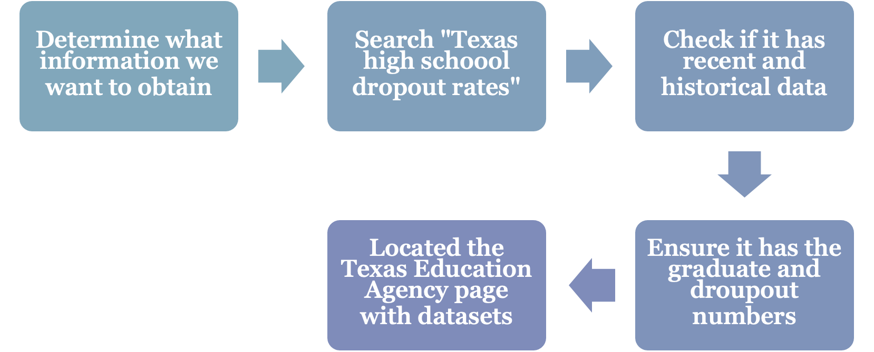
Measure: Process Map
Texas Education Agency. (n.d.). Completion, Graduation, and Dropout Data. Retrieved from Texas Education Agency: https://tea.texas.gov/reports-and-data/school-performance/accountability-research/completion-graduation-and-dropout/completion-graduation-and-dropout-data

Slide 10
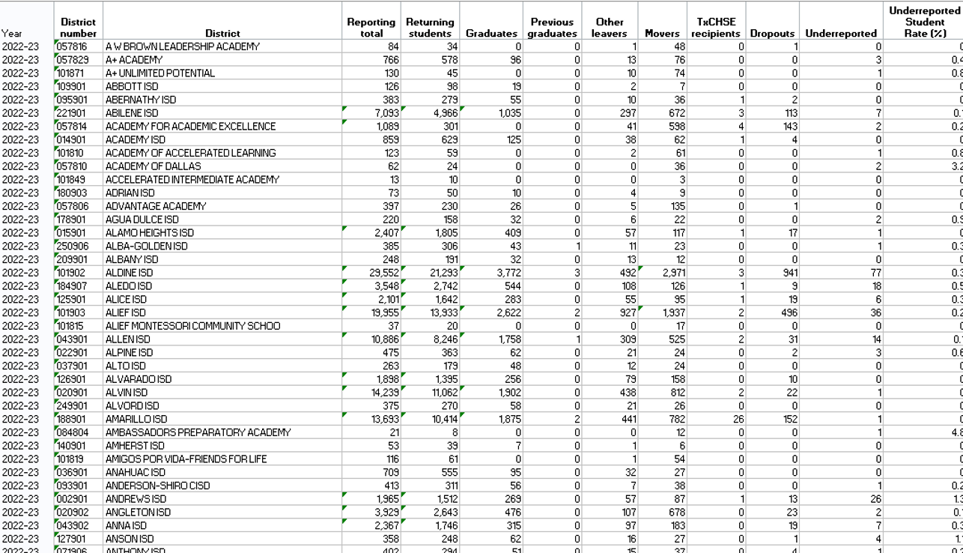
Raw Data
Term Project Raw Data.xlsx
Data type: Quantitative
Raw data contained 5843 rows and 13 columns
Measured: Percentage of students dropping out per school year
Variables:
Access to counseling
Demographics
Socioeconomic status
Student Engagement
KPI’s:
Graduation Rates
Enrolment and Retention
Student Performance Predictions
Persistence Rates
Data was collected by the Texas Education Agency (TEA)
Texas Education Agency. (n.d.). Completion, Graduation, and Dropout Data. Retrieved from Texas Education Agency: https://tea.texas.gov/reports-and-data/school-performance/accountability-research/completion-graduation-and-dropout/completion-graduation-and-dropout-data

Slide 11
Data Collection Plan
Metric | Reason for Collection | Operational Definition | Data Source | Who will collect?
Dropout rate | To show the amount of high school students not completing their schooling. | The percentage of students who do not complete a study or program. | Texas Education Agency (TEA) | Team
Demographics | To demonstrate how demographics have an impact on the high school dropout rate. | Statistics that describe a population and their characteristics | Texas Education Agency (TEA) | Team
Economic Status | To show the impact economic status has on students and their schooling. | The perpetuation of a family’s social class or position in the distribution of income across generations. | Texas Education Agency (TEA) | Team
Texas Education Agency. (n.d.). Completion, Graduation, and Dropout Data. Retrieved from Texas Education Agency: https://tea.texas.gov/reports-and-data/school-performance/accountability-research/completion-graduation-and-dropout/completion-graduation-and-dropout-data

Slide 12
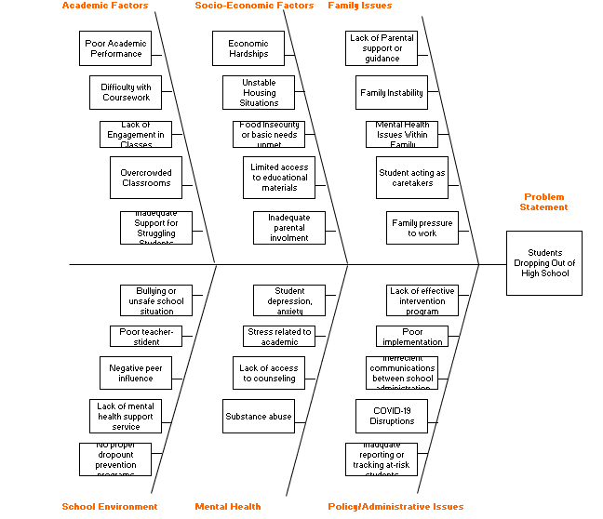
Root Cause Analysis
Freeman, J., & Simonsen, B. (2015). Examining the Impact of Policy and Practice Interventions on High School Dropout and School Completion Rates: A Systematic Review of the Literature. Review of Educational Research, 85(2), 205-248. https://doi.org/10.3102/0034654314554431

Slide 13
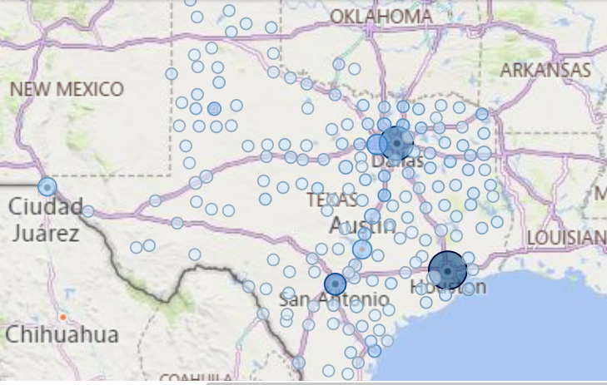
Improve: Planning
The three major cities with the highest dropout rates are:
The Houston area and nearby counties, which have the highest rates.
The Dallas-Fort Worth area, which ranks second.
In the Houston area, Harris County stands out, with approximately 8,500 dropout students recorded during the 2022-23 academic year.
Texas Education Agency. (n.d.). Completion, Graduation, and Dropout Data. Retrieved from Texas Education Agency: https://tea.texas.gov/reports-and-data/school-performance/accountability-research/completion-graduation-and-dropout/completion-graduation-and-dropout-data

Slide 14
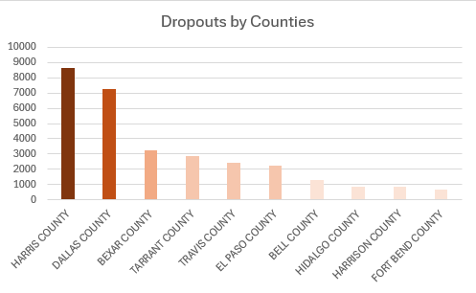
Improve: Overall Graphical Representation
The top 10 counties in Texas with the highest number of dropout students accounted for approximately 80% of all dropout students in the state.
Texas Education Agency. (n.d.). Completion, Graduation, and Dropout Data. Retrieved from Texas Education Agency: https://tea.texas.gov/reports-and-data/school-performance/accountability-research/completion-graduation-and-dropout/completion-graduation-and-dropout-data

Slide 15
Improve: Budget For Harris County
Allocate approximately $1.5 million annually for intervention programs.
Breakdown:
$500,000: Support programs (e.g., tutoring, mentoring, and counseling).
$400,000: Community outreach initiatives and family support.
$300,000: Training educators and staff for dropout prevention strategies.
$300,000: Monitoring and evaluation of program effectiveness.

Slide 16
What experts are saying
Programs like AVID and Early College High Schools have improved graduation rates and college readiness.
Communities In Schools reports success stories from students who received additional support and completed high school.
Effective programs provide targeted academic and emotional support to address specific needs of at-risk students.
Broader factors like economic instability, lack of healthcare, and family stressors continue to impact dropout rates‌
“National Dropout Prevention Center.” Dropoutprevention.org, 2022,
dropoutprevention.org/effective-strategies/.
“Evaluating the Impact of Early College High Schools.” American Institutes for Research,
www.air.org/project/evaluating-impact-early-college-high-schools.
‌
‌

Slide 17

Time Frame
Project Duration: 2 years (until May 2026).
Phase 1: June 2024 - December 2024: Research and analysis of key dropout factors.
Phase 2: January 2025 - December 2025: Implementation of targeted programs and interventions.
Phase 3: January 2026 - May 2026: Monitoring, evaluating outcomes, and preparing final report.

Slide 18

Control: SOPs
Objective: Identify the students who are nearing risk or at risk of dropping out of high school
Responsibility on: Teachers, Parents, Counselors, and Administrators
Procedure: 1. Continue to collect data about student attendance, grades, tutoring 2. Implement Early Warning System (EWS) 3. Intervene when a student has more than 5 unexcused absences or grade falls to 75 4. Set up action plan 5. Follow up with surveys for teachers and administrator
“Dropout Prevention Framework | CDE.” Www.cde.state.co.us, 22 Apr. 2024, www.cde.state.co.us/dropoutprevention/dpframework. Accessed 15 Nov. 2024.

Slide 19
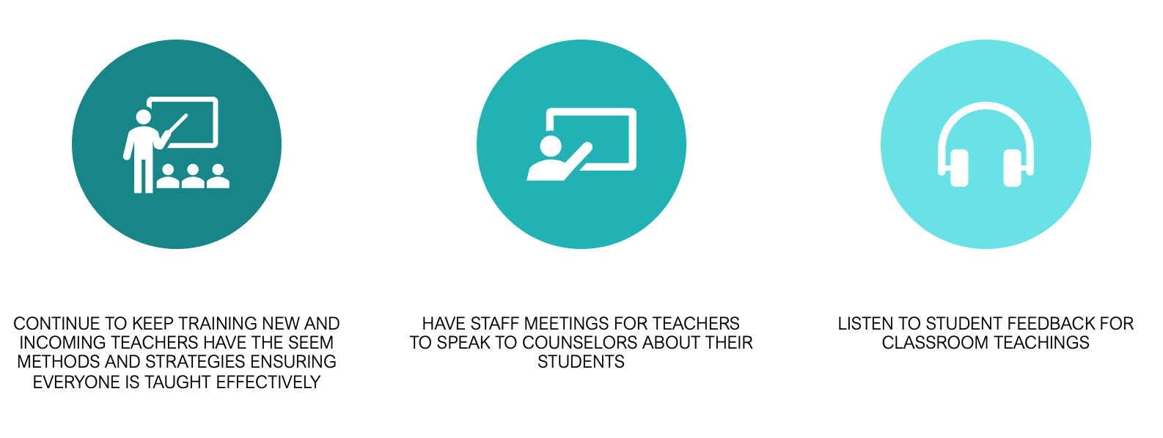
Control: Sustaining Change

Slide 20
Tools for Data Analysis
Python (Pandas, Matplotlib, Seaborn): For data cleaning and visualization
Excel: For quick pivot tables and summarization
Power BI/Tableau: For interactive dashboards and data visualization
R: For advanced statistical modeling and correlation analysis

Slide 21
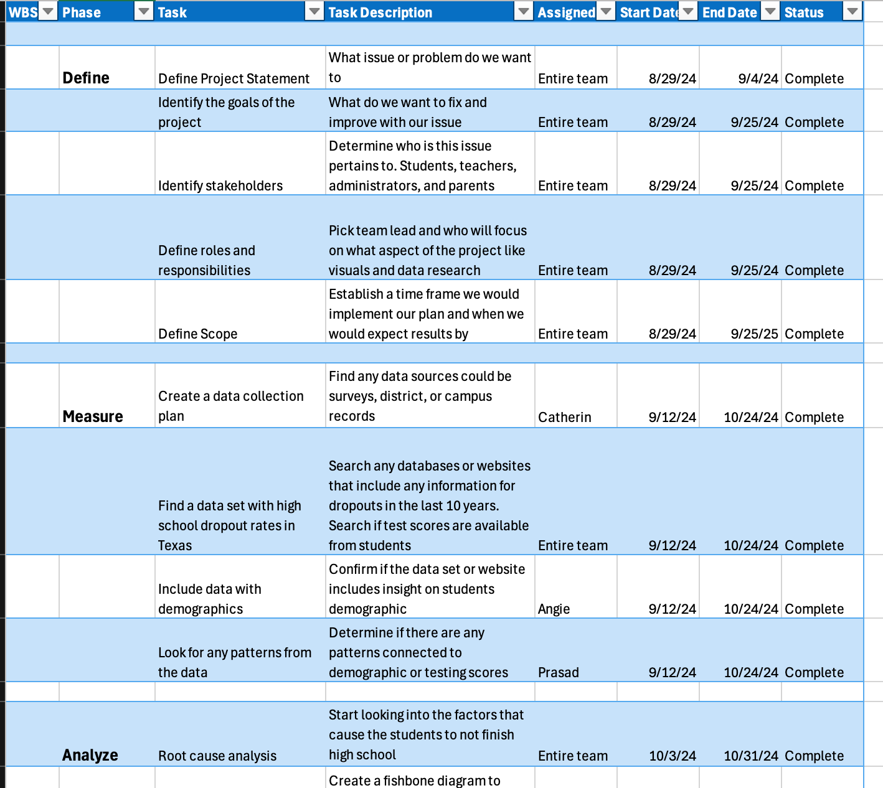
Work Breakdown Schedule
WBS Team 1

Slide 22
Conclusion
After defining our problem and implementing the DMAIC process it can allow us to reduce Texas' high school dropout rates by 1% by May 2026

Slide 23
Sources
“National Dropout Prevention Center.” Dropoutprevention.org, 2022, dropoutprevention.org/effective-strategies/.
“Evaluating the Impact of Early College High Schools.” American Institutes for Research, www.air.org/project/evaluating-impact-early-college-high-schools.
Ref: Foster, P. (2022, September 27). 6 Advantages of Having A High School Diploma | Penn Foster. Www.pennfoster.edu. https://www.pennfoster.edu/blog/advantages-of-having-a-high-school-diploma
Dropout Prevention Framework | CDE.” Www.cde.state.co.us, 22 Apr. 2024, www.cde.state.co.us/dropoutprevention/dpframework. Accessed 15 Nov. 2024.
Austin. Secondary School Completion and Dropouts in Texas Public Schools 2021-22 TEXAS EDUCATION AGENCY. 2023. https://tea.texas.gov/reports-and-data/school-performance/accountability-research/dropcomp-2021-22.pdf
‌Freeman, J., & Simonsen, B. (2015). Examining the Impact of Policy and Practice Interventions on High School Dropout and School Completion Rates: A Systematic Review of the Literature. Review of Educational Research, 85(2), 205-248. https://doi.org/10.3102/0034654314554431
Wilson, S. J., Tanner‐Smith, E. E., Lipsey, M. W., Steinka‐Fry, K., & Morrison, J. (2011). Dropout prevention and intervention programs: Effects on school completion and dropout among school‐aged children and youth. Campbell Systematic Reviews, 7(1), 1-61.
Stanard, R. P. (2003). High school graduation rates in the United States: Implications for the counseling profession. Journal of Counseling & Development, 81(2), 217-221. https://onlinelibrary.wiley.com/doi/abs/10.1002/j.1556-6678.2003.tb00245.x
Texas Education Agency. (n.d.). Completion, Graduation, and Dropout Data. Retrieved from Texas Education Agency: https://tea.texas.gov/reports-and-data/school-performance/accountability-research/completion-graduation-and-dropout/completion-graduation-and-dropout-data
‌

Slide 24

Thank you!

